Slide 1

Autonomous Waypoint Navigation Software for Raspberry Pi 5
Shawn Kim

Slide 2
Introduction
This software program enables autonomous waypoint navigation for a mobile platform using a Raspberry Pi 5.
The system uses GPS data to guide the platform from one location to another along a predefined series of static waypoints.

Slide 3

Requirements Coverage

Slide 4
Requirements Coverage: Requirements Matrix
Requirement | Status
Interface with GPS module via USB or GPIO serial | Implemented
Calculate real-time position and heading from GPS input | Implemented
Develop waypoint-following algorithm | Implemented
Implement proximity detection for waypoint arrival | Implemented
Output navigation heading and velocity commands | Implemented
Configurable waypoints via JSON or CSV file | Implemented
Documentation on waypoint file interpretation | Implemented
Fault detection for GPS signal loss | Implemented
Log navigation decisions with timestamps | Implemented
Use Raspberry Pi 5 with 64-bit Debian-based OS | Implemented
Programming language Python 3 or C++ | Implemented
Use pyserial, pynmea2, or gpsd for GPS communication | Implemented
Navigation math with numpy | Implemented
Optional visualization with matplotlib or folium | Deferred
Provide file I/O for waypoints and logs | Implemented
Optional CLI or GUI for system control | Deferred
Complete software package tested on Raspberry Pi 5 | Implemented
Provide biweekly status reports | Implemented
Documentation: code comments, README, setup and troubleshooting instructions | Implemented
Test Report for navigation between at least 3 waypoints | Implemented
Presentation of completed software | Implemented

Slide 5
Requirements Coverage: References
Statement of Work for Taewoo_051425.docx
Autonomous Waypoint Navigation System Test Report.docx

Slide 6

Technical Requirements

Slide 7
Technical Requirements: Tool Stack
Platform: Raspberry Pi 5 OS Lite
Programming Languages: C/C++23, Shell, Python
GPS Driver: gpsd, gpsd-clients
Build Tools: git, cmake, clang/gcc, sanitizer
C++ Libraries: libgps, concorde, nlohmann_json
Python Libraries: matplotlib

Slide 8
Technical Requirements: Tool Stack (cont’d)
Raspberry Pi OS Lite (64-bit Debian Bookworm): Operating system platform for software deployment.
C++: Core programming language for system logic and navigation computations.
Python: Used data visualization of waypoint visitation order
gpsd/gpsd-clients: Daemon to interface and read GPS data from the dongle.
Git: Used to pull repo on Raspberry Pi
Cmake: Used to configure the build and compilation of the C++ project.
Clang/GCC & Address Sanitizer: Used to compile the project and address sanitizers were used as a tool for memory leak detection and ensuring software stability.
Libgps: C++ library to interface with gpsd-managed socket through API.
Concorde TSP Solver: Solver for Traveling Salesman Problem used for waypoint planning.
Nlohmann_json: C++ JSON library for navigation output.
Matplotlib: Python library to plot planned navigation route.

Slide 9
Technical Requirements: Interfaces
Navigation software includes CLI to specify required files/directories:
‘.csv’ file/directory to load in user-defined static waypoints
‘.tsp’ directory to communicate with Concorde TSP Solver
‘.sol’ directory to write out Concorde visiting order solution
‘.log’ directory to log navigation output
‘.png’ directory to plot tour of waypoints
Details of these file interfaces are documented in the Git repository.

Slide 10
Test Automation

Slide 11
Test Automation: Summary
Automated Test Coverage:
Over 50% of all required tests have been automated.
Automated tests covers navigation algorithm correctness.
Tested in the “run” phase of the CI/CD pipeline after the system has been built and installed in Raspberry Pi OS-like environment (Debian Bookworm).
Success criteria is the successful completion of the “run” phase.
The other tests that were performed manually were navigation logging that demonstrated GPS input handling, proximity detection, and output reliability.
Execution Results:
Automated tests include waypoint CSV scenarios ranging from 5 to 50 waypoints.
Test results clearly documented in “Autonomous Waypoint Navigation System Test Report.docx”, demonstrating successful and consistent verification.
Automation Tools Used:
GitLab CI/CD (.gitlab-ci.yml)

Slide 12
Static Analysis

Slide 13
Static Analysis: Summary
Static Analysis Tools:
Utilized compiler-integrated tools (Clang/GCC Address Sanitizer) for static and dynamic analysis.
Summary of Findings:
No high or medium-severity issues identified.
All identified minor issues were resolved during iterative development and testing cycles.
Risk Assessment:
Final software is assessed as low-risk, demonstrating reliability, safety, and stability.
Memory leaks, undefined behaviors, and potential crashes thoroughly investigated and mitigated.
Evidence of Assurance:
GitLab CI/CD process builds and runs program with a run-time address sanitizer that does not trigger during execution and after completion of program.

Slide 14
CI/CD Pipeline

Slide 15
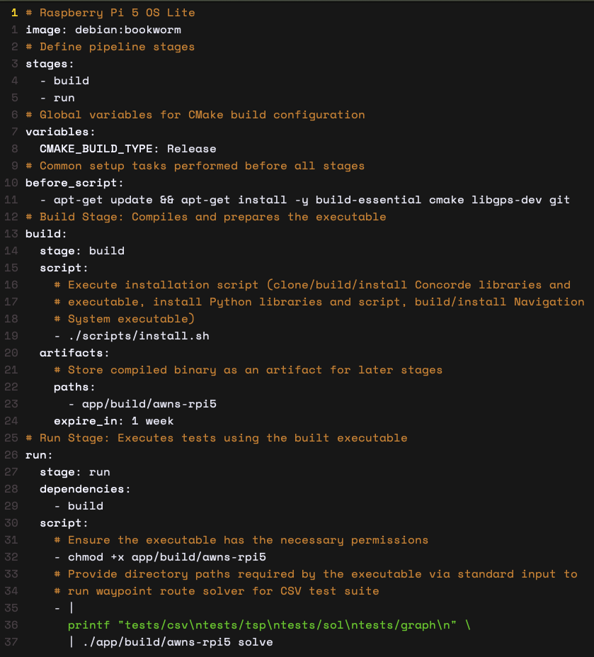
CI/CD Pipeline: .gitlab-ci.yml

Slide 16
Software Bill of Materials

Slide 17
Software Bill of Materials
Project Name: Autonomous Waypoint Navigation Software
Platform: Raspberry Pi 5 (Debian-based OS)
Author of SBOM: Shawn Kim (Software Developer)
SBOM Assembly Date: June 25, 2025

Slide 18
SOBM: Project-developed Software
Component | Version | Supplier | Libraries/Dependencies | Dependency Relationship | License | Notes
Autonomous Navigator (C++) | v1.0.0 | Team-developed | STL, filesystem, chrono, iostream | Core Application | MIT (project default) | Primary software logic

Slide 19
SOBM: Open-source and Third-party Components
Component | Version | Supplier/Source | Libraries Used | Dependency | License | Known Vulnerabilities | Notes
Concorde TSP Solver | 03.12.19 | Concorde TSP | Standalone Binary (no direct API/library calls) | Waypoint Optimization | Academic Free License | None Reported | Binary integration, no direct linking
GPSD | 3.25 | GPSD Project | libgps-dev | GPS Input | BSD License | None Reported | Used for GPS integration
nlohmann/json | 3.11.2 | JSON for Modern C++ | Header-only | JSON Config Parsing | MIT License | None Reported | Configuration parsing and output formatting

Slide 20
SOBM: Development and Test Environment Tools
Tool | Version | Supplier | Dependency Relationship | License | Known Vulnerabilities | Notes
Debian (Bookworm) | 12 | Debian | Base OS | GPLv2 | None Reported | Development and CI/CD pipeline container image
Clang/GCC Compiler Suite | Clang ≥16, GCC ≥13 | LLVM Project, GNU Compiler Collection | Compilation and Analysis | GPLv3 (GCC), Apache 2.0 (Clang) | None Reported | Address sanitizer used for static/dynamic analysis

Slide 21
SOBM: Additional Information
All source code components and build scripts are hosted in the project repository: github.com/kimsh02/awns-rpi5.
Dependency relationships and licenses were verified as of SBOM assembly date.
No known vulnerabilities were reported in the components used at the time of assembly.

Slide 22

System Integration

Slide 23
System Integration: Hardware Modules
Raspberry Pi 5 (16GB)
Raspberry Pi 5 charger (CanaKit 45W USB-C Power Supply with PD for Raspberry Pi 5 (27W @ 5A))
GPS Dongle (VK-162 G-Mouse USB GPS Dongle Navigation Module External GPS Antenna Remote Mount USB GPS Receiver for Raspberry Pi Support Google Earth Window Linux Geekstory)
A flash drive (8GB+)

Slide 24

Navigation Algorithm

Slide 25
Navigation Algorithm: Traveling Salesman Problem (TSP)
The Traveling Salesman Problem (TSP) is a classic optimization problem where a salesman must find the shortest route to visit a number of cities exactly once and return to the starting point.
This is the problem that the navigation algorithm is trying to solve.

Slide 26
Navigation Algorithm: Concorde TSP Solver
The Concorde TSP solver is a software package designed to solve the symmetric traveling salesman problem (TSP) and related network optimization problems.
It is known for its ability to find provably optimal solutions for large TSP instances using a branch-and-cut algorithm.
For this reason, Concorde is the static waypoint planner chosen for the navigation system.

Slide 27
Navigation Algorithm: Concorde TSP Solver (cont’d)
The authors didn’t intend for anyone to use it as a C/C++ API in other projects; it was written as a research-grade standalone solver, not a reusable library.
Academic software like Concorde entails
Solving a big math problem (TSP) and winning all the benchmarks
But not exporting most functions and little to no API documentation
Acceptable usage is to build the full binary and call it as it does in the navigation system.
Details are documented in the Git repository.

Slide 28
Navigation Algorithm: Proximity Detection
The GPS module is accurate up to around ~3-5 meters in an urban environment.
Idea is to set a proximity radius threshold for determining arrival at each waypoint.
Do this by comparing the current position of the navigation system to the position of the current waypoint that it is visiting.
Conceptually, we are computing the Euclidean distance between two points.

Slide 29
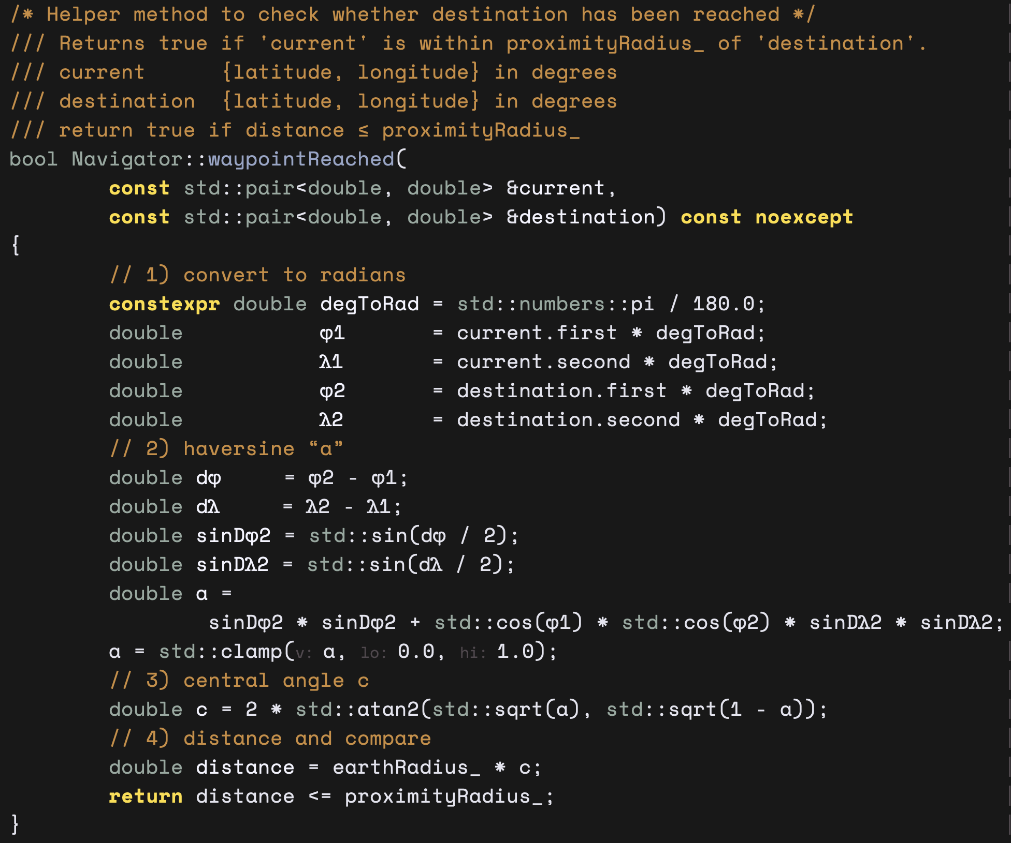
Navigation Algorithm: Proximity Detection (cont’d)
Because the Earth is (roughly) a sphere, Euclidean (flat) distance formulas are inaccurate over large distances. The Haversine formula accounts for Earth’s curvature.
The Haversine formula is a mathematical method used to calculate the great-circle distance (shortest distance over the Earth’s surface) between two points specified by their latitude and longitude.

Slide 30

Autonomous Control Input

Slide 31
Autonomous Control Input: Navigation Output
Logged to stdout and optionally to a log file if the user specifies a log directory in the CLI
Generated in JSON string format
JSON is a popular and universal format choice for data exchange
Suitable for interpretation of directions by a downstream motion controller or vehicle controller.

Slide 32
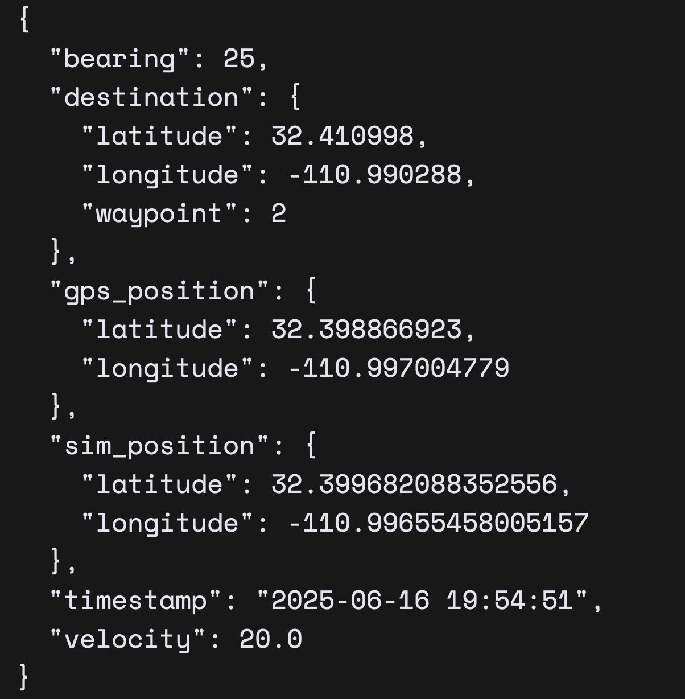
Autonomous Control Input: Navigation Output for Simulated Velocity
Bearing: reported as degrees from true North
Destination: reported in latitude, longitude, and waypoint which is the order number in which the coordinate was read from the .csv file
GPS Position: reported in latitude, longitude as it was polled from the GPS dongle
Simulated Position: reported in latitude, longitude as it was computed from the user-set simulated velocity (for debugging)
Timestamp: reported in YYYY-MM-DD Hour-Minute-Second format
Velocity: user-set simulated velocity reported in meters per second
Used for debugging and/or when there is no downstream motor controller.

Slide 33
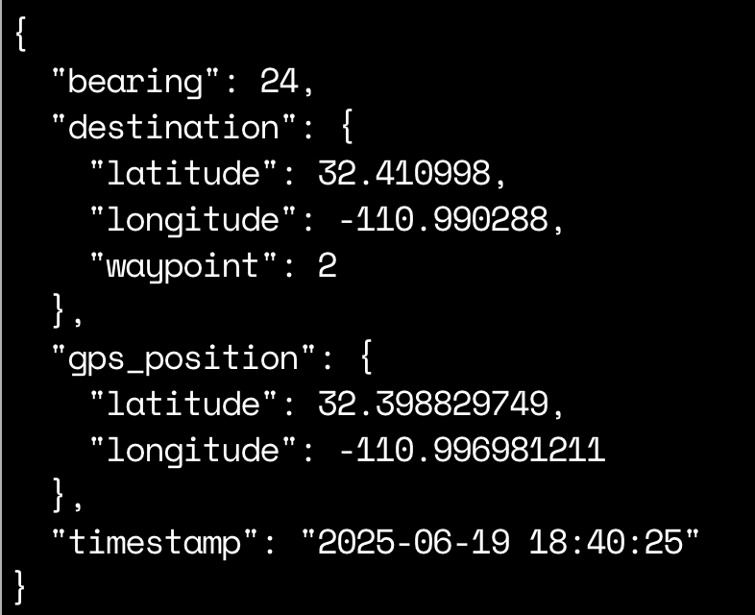
Autonomous Control Input: Navigation Output for GPS
Bearing: reported as degrees from true North
Destination: reported in latitude, longitude, and waypoint number as it was read from the .csv file
GPS Position: reported in latitude, longitude as it was polled from the GPS dongle
Timestamp: reported in YYYY-MM-DD Hour-Minute-Second format
Used for passing directions to a downstream motor controller
Realistically, only the `bearing` value is of interest to the controller

Slide 34
Configurability

Slide 35
Configurability: Waypoints
The program will read in a series of static waypoints via a .csv file
Through a user-specified file/directory input in the CLI.
Must have two columns with headers specifying latitude and longitude and in that order.
A tests/csv directory is included in the Git repository providing test CSV files.
Documentation of this is also specified in the Git repository.

Slide 36
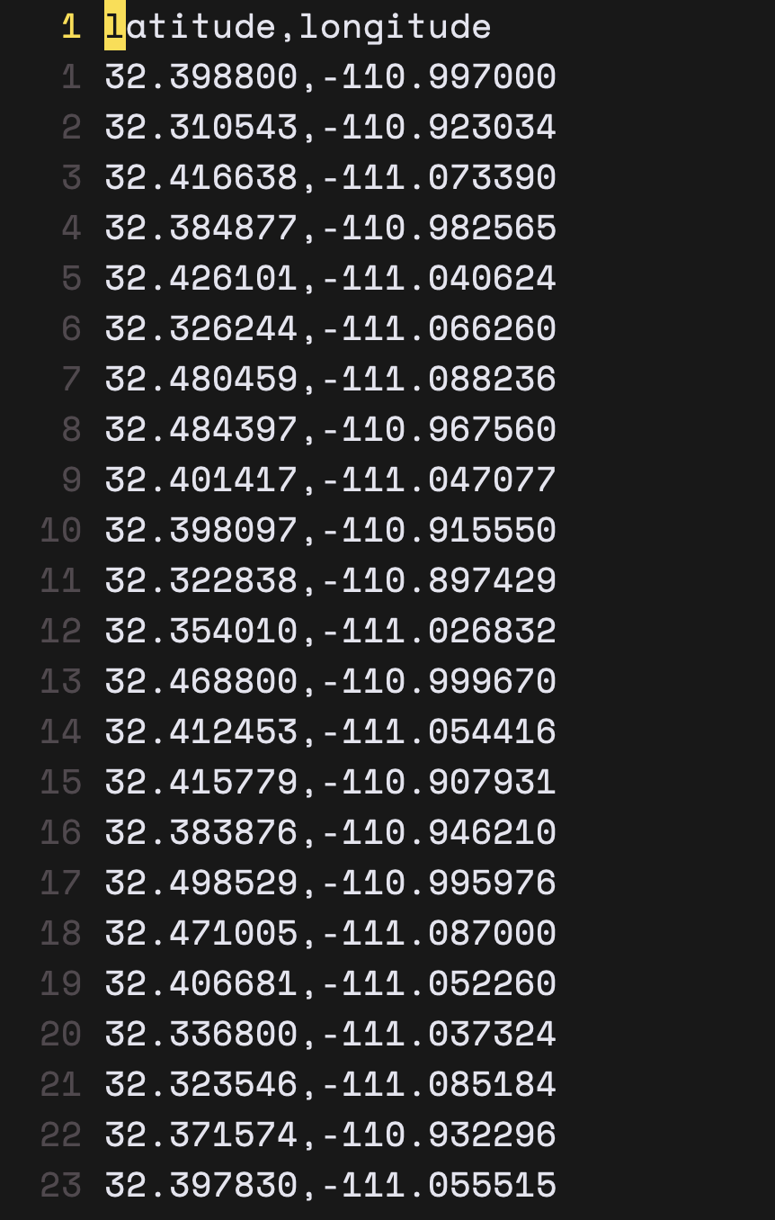
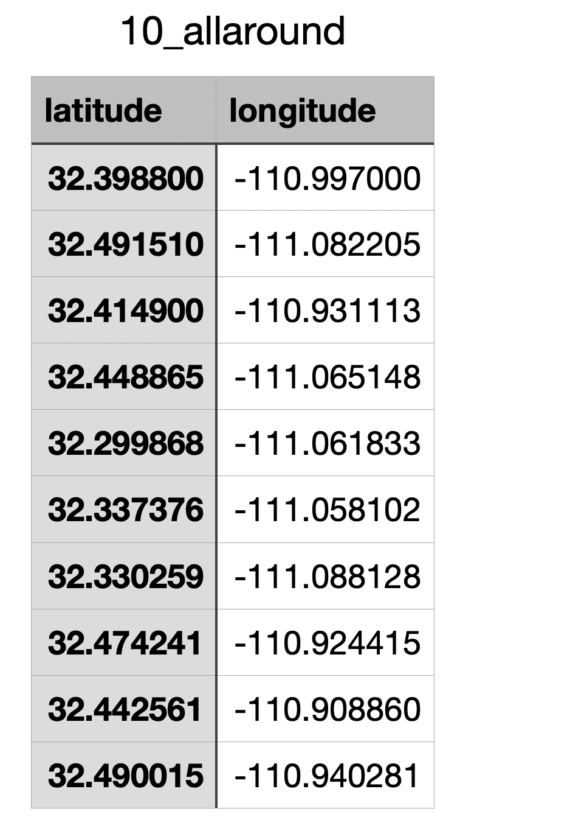
Configurability: Waypoints (cont’d)

Slide 37

Fail-Safes and Logging

Slide 38
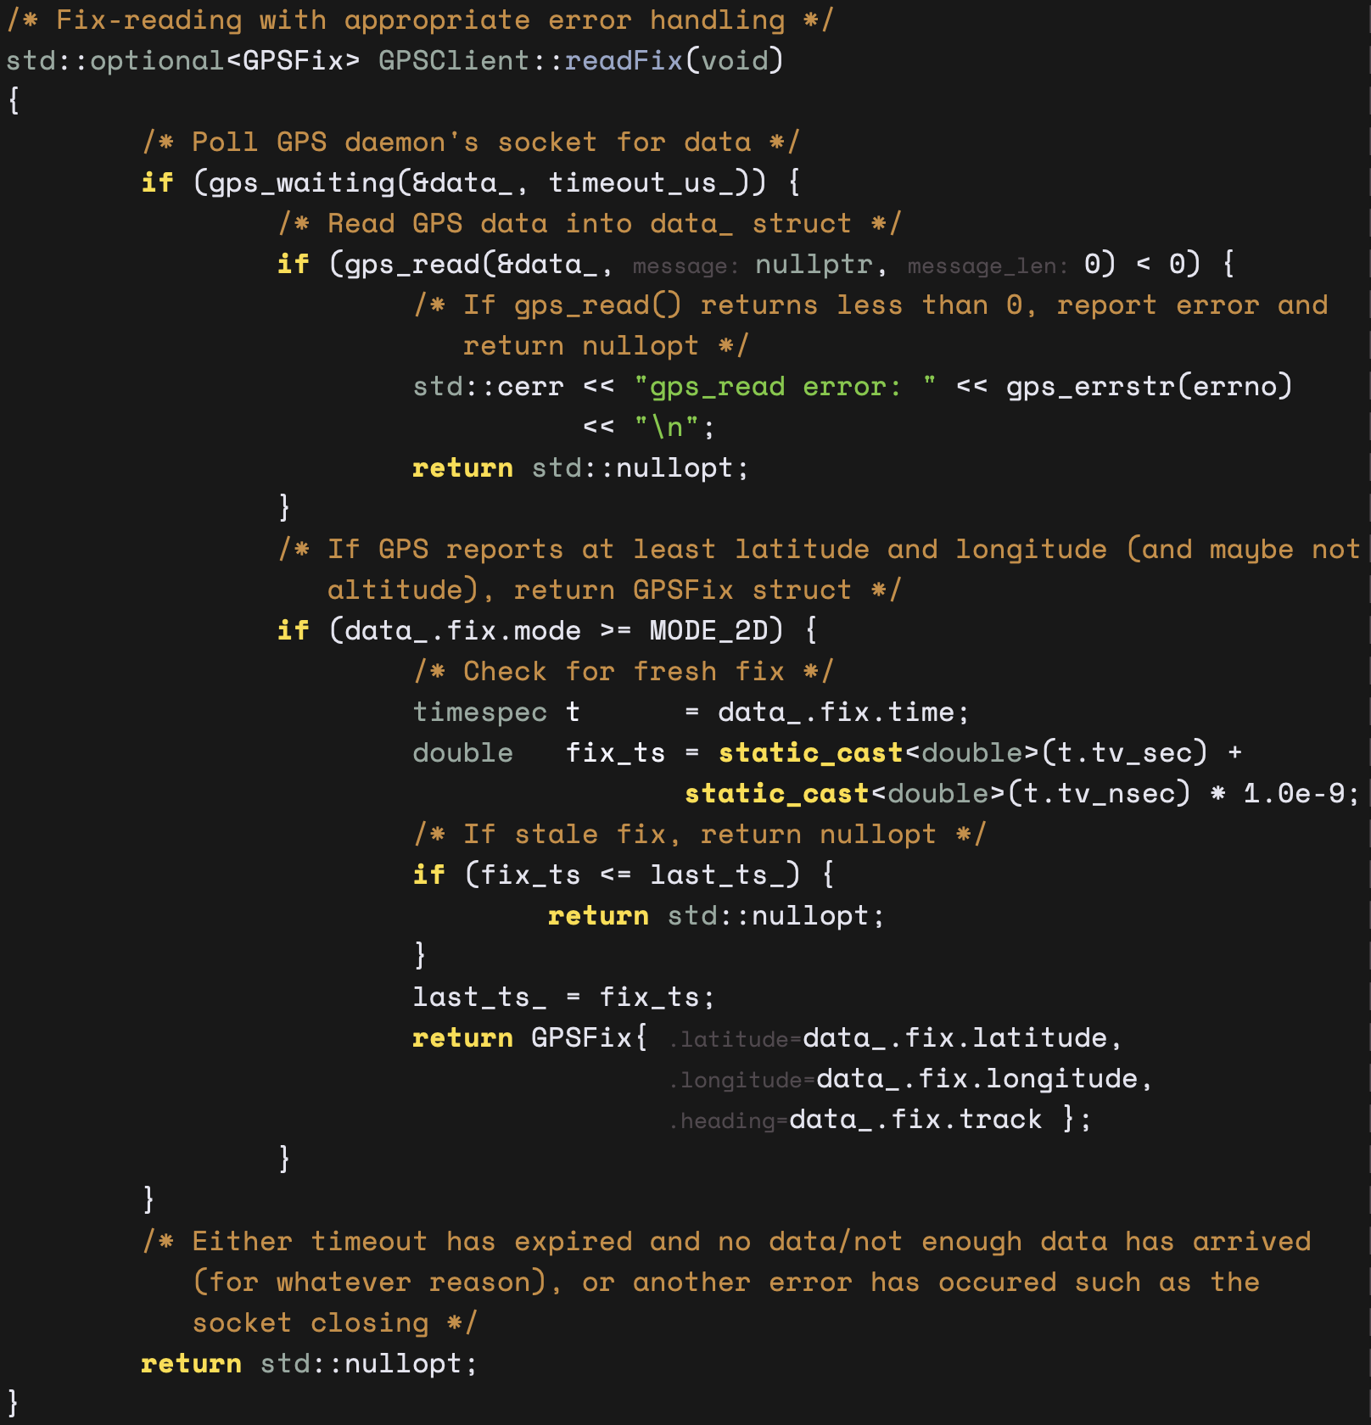
Fail-Safes and Logging: Fault Detection
Gracefully logs errors and exits upon failure to connect to the GPS stream or upon detection of GPS signal loss during execution.
Handles other signal jitters including
GPS stream read errors
Insufficient GPS data (it at least needs to report 2D coordinates)
Stale GPS data in socket
GPS read timeouts
Lenient GPS polling logic is policy in case of failed attempts due to the above

Slide 39
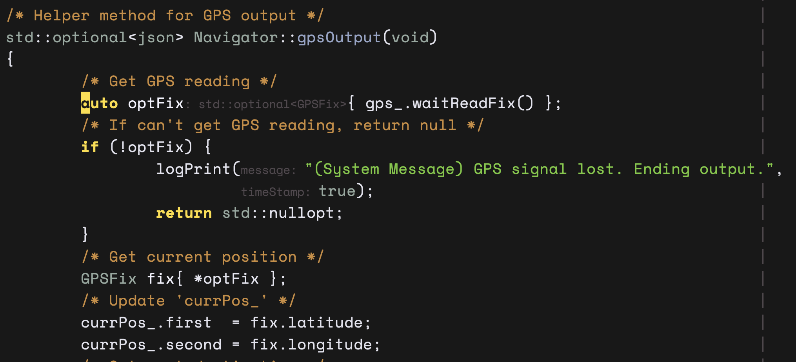
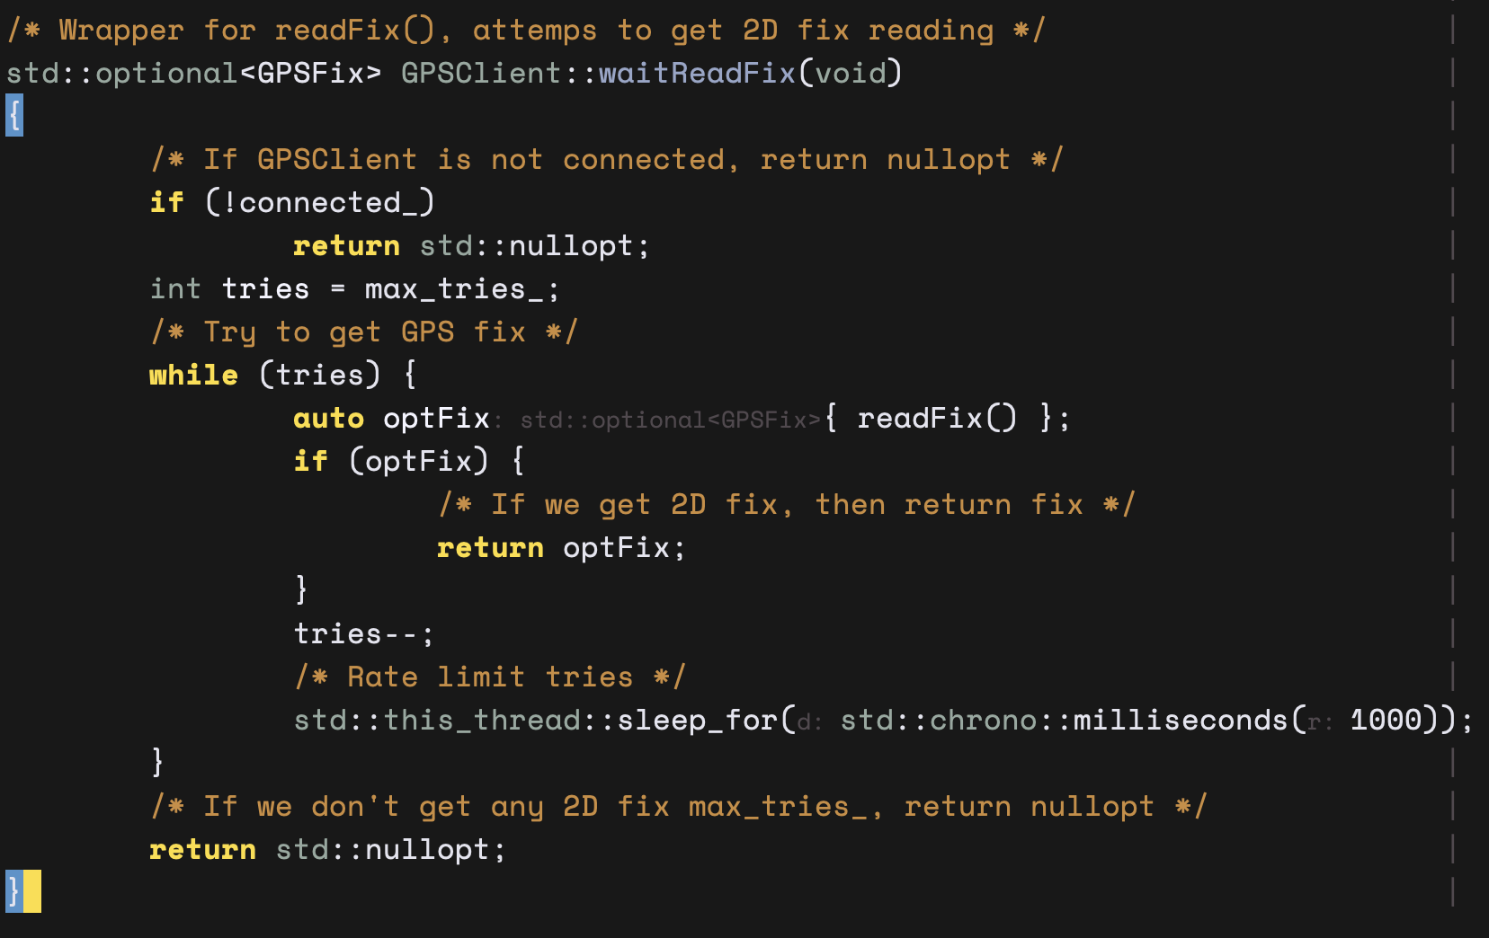
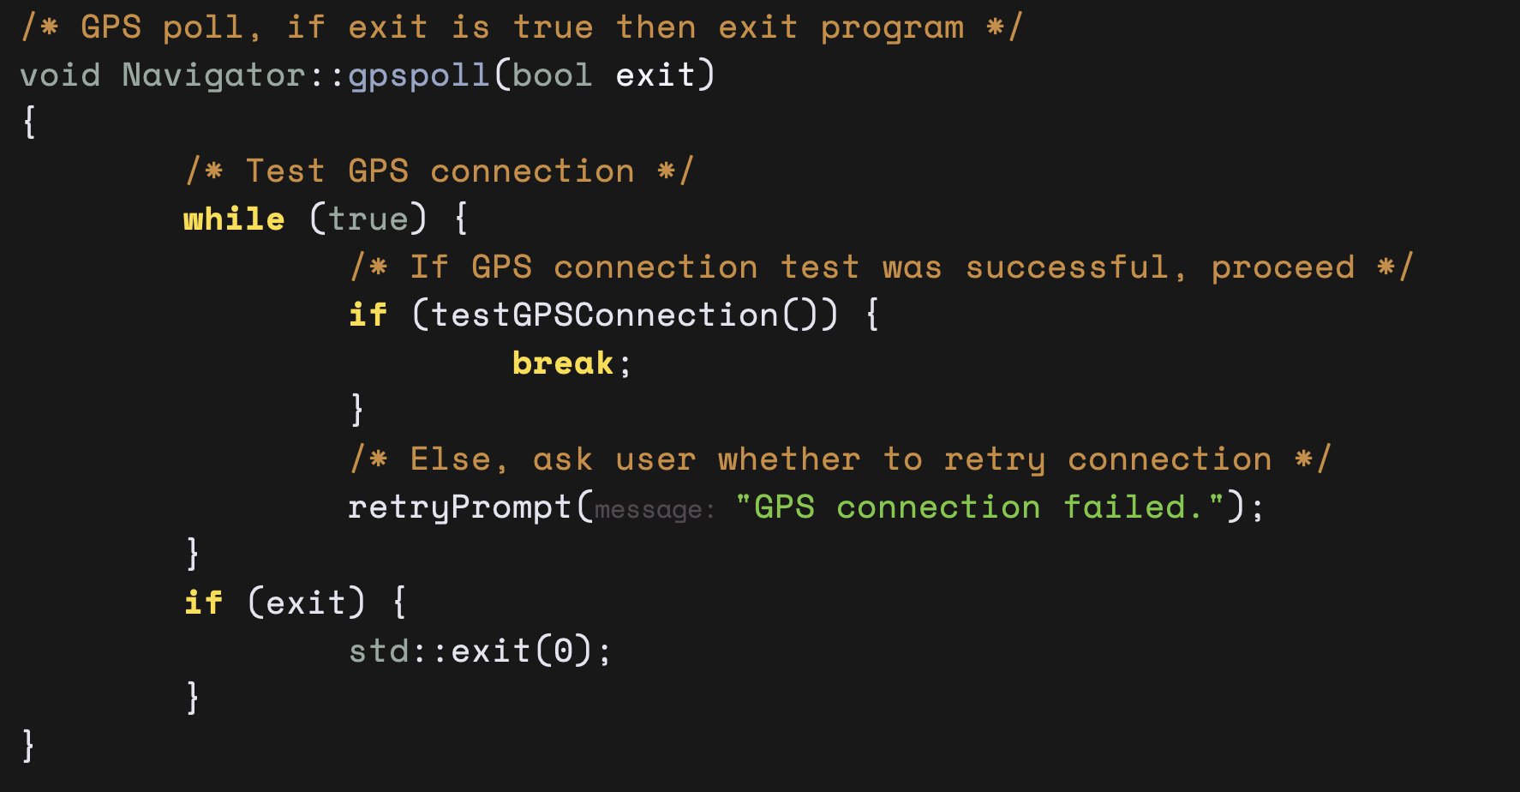
Fail-Safes and Logging: Fault Detection (cont’d)

Slide 40

Documentation

Slide 41
Documentation: API
The developer can modify the source code as they see fit.
As-is, the navigation system provides a simple API that can be integrated with the development of a downstream motor controller.
The idea is to work with a ‘Navigator’ object in the code
Has a total of 5 methods that you can call

Slide 42
Documentation: API (cont’d)
Headers
#include "navigator.hpp”
Methods
Navigator(int argc, const char **argv) noexcept
void start(void)
void setProximityRadius(double r) noexcept
void setSimulationVelocity(double v) noexcept
std::optional<json> getOutput(void)
Git repository documents specifics of the API
‘main.cpp’ contains an example usage of initializing and running the navigator.

Slide 43

Test Report

Slide 44
Test Report: Brief
Navigation system can plan visiting order of 50+ waypoints in less than 1 second.
Plots a visualization of the visiting order via an installed Python script.
Full testing suite and results are uploaded in the ‘tests/csv’ and ‘tests/graph’ directories in the Git repository.
Sample navigation logs are uploaded in the ‘tests/log’ directory.

Slide 45

Test Report: Navigation Planner Correctness

Slide 46
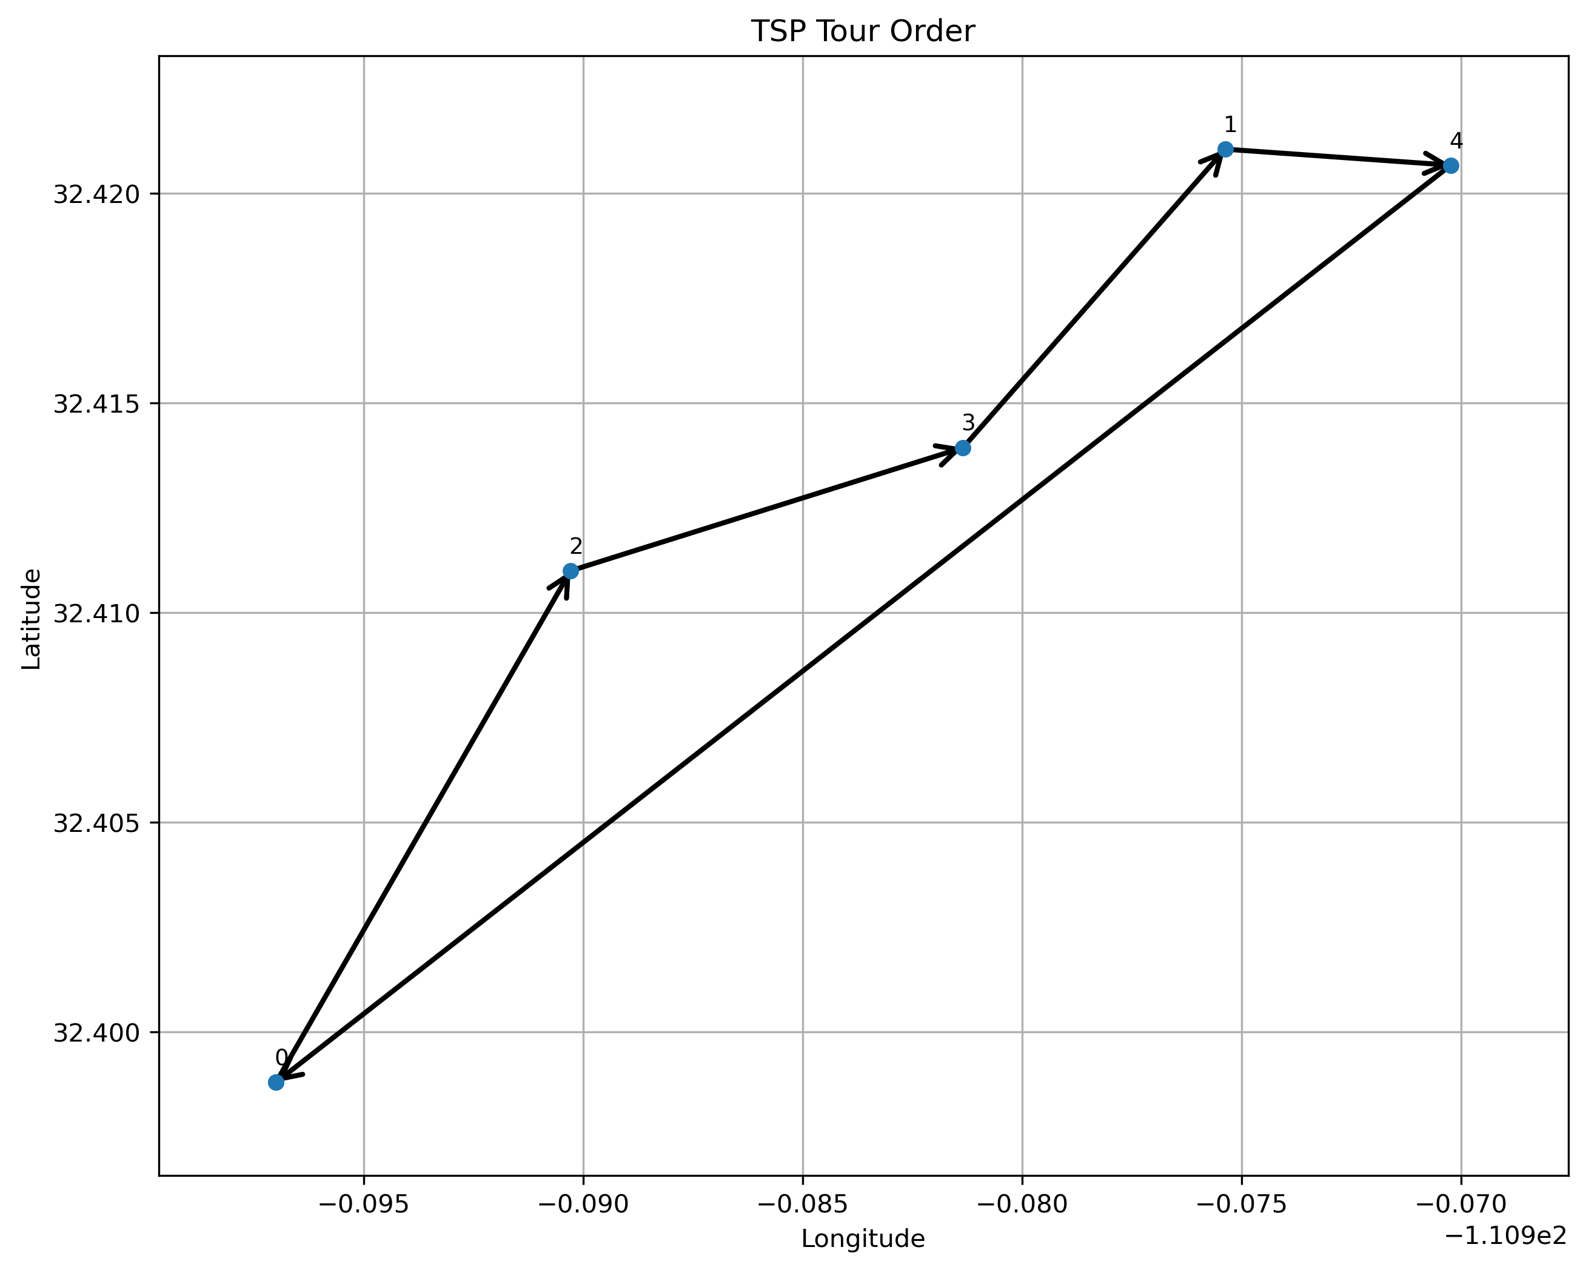
Test Report: 5_line.csv (0.004235 s)

Slide 47
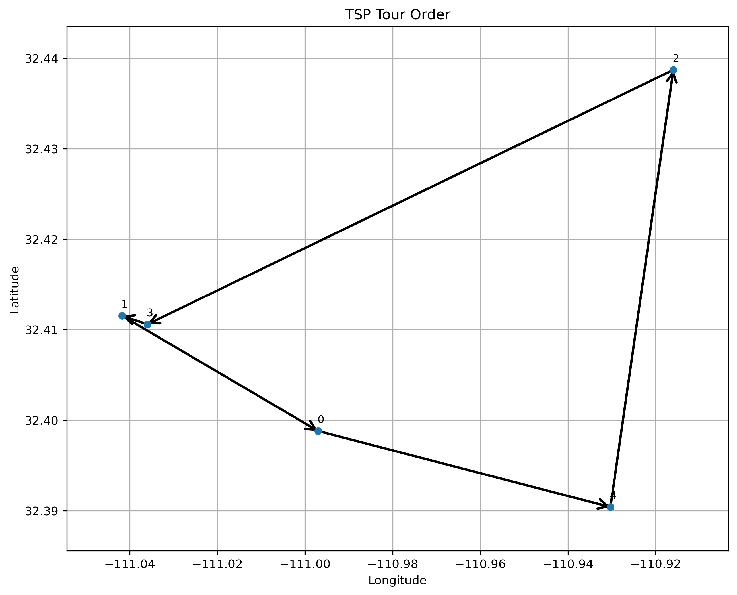
Test Report: 5_allaround.csv (0.003660 s)

Slide 48
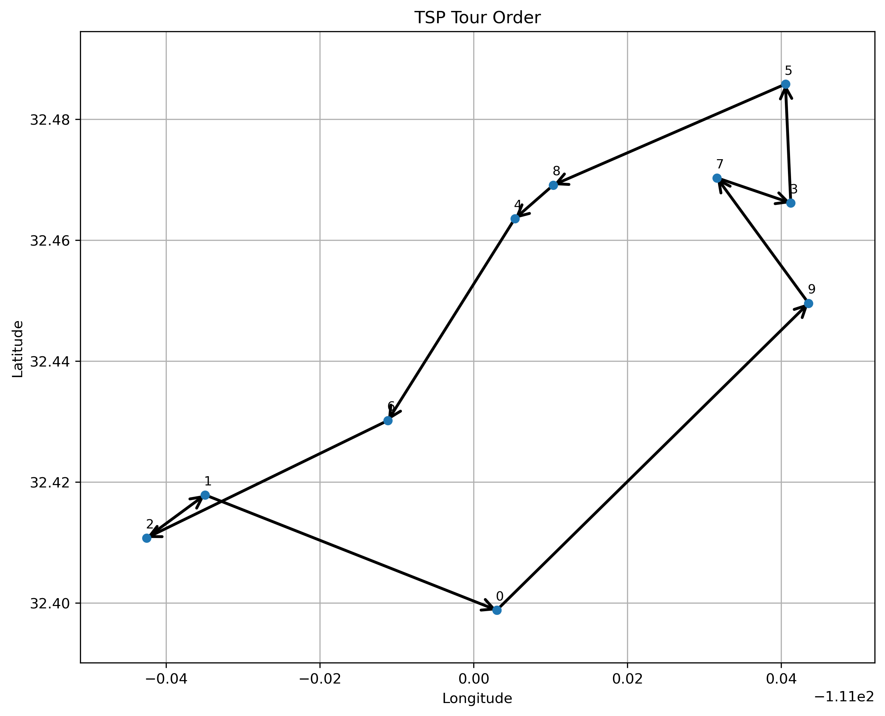
Test Report: 10_oneside.csv (0.002295 s)

Slide 49
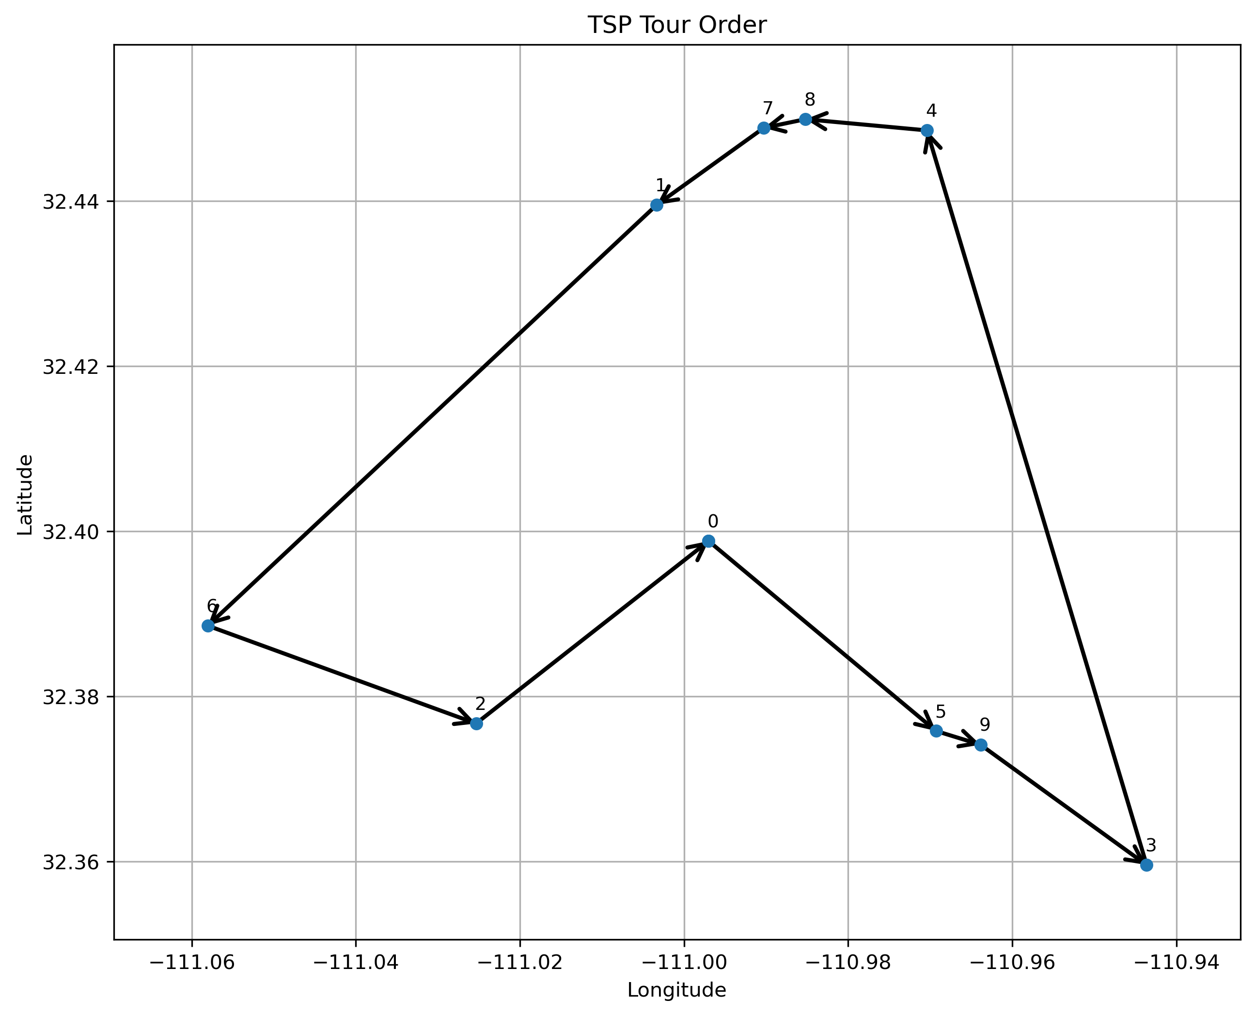
Test Report: 10_clusters.csv (0.002183 s)

Slide 50
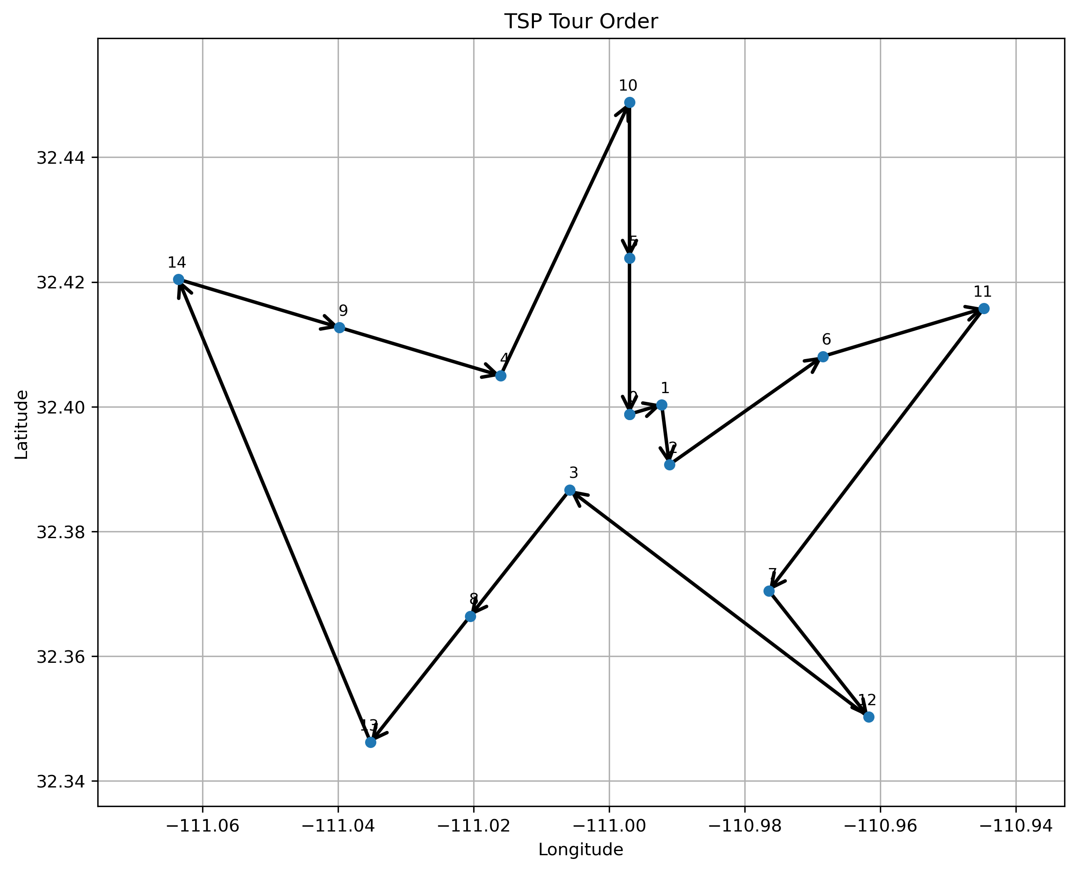
Test Report: 15_spiral.csv (0.008457 s)

Slide 51
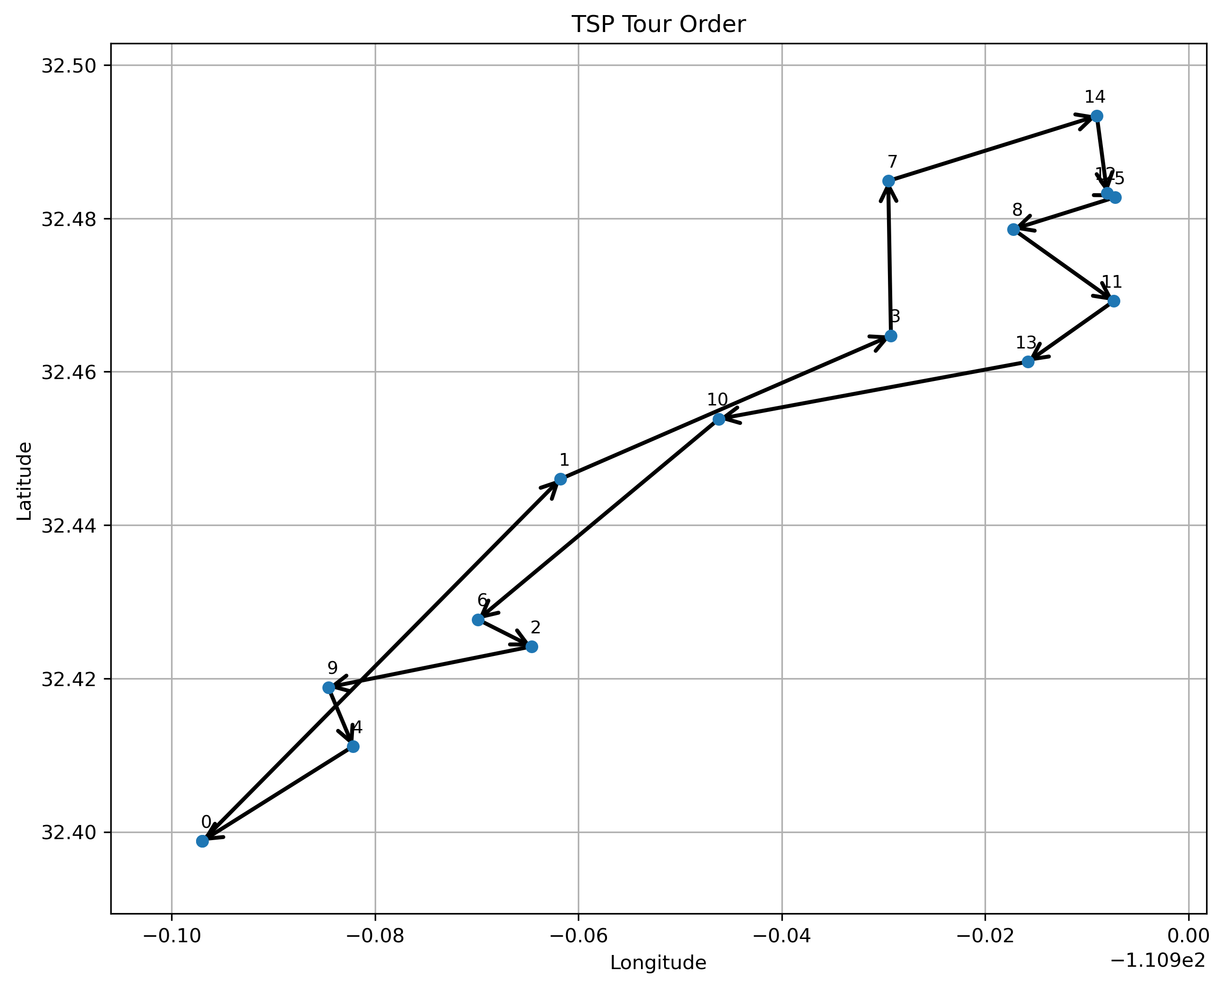
Test Report: 15_line.csv (0.007012 s)

Slide 52
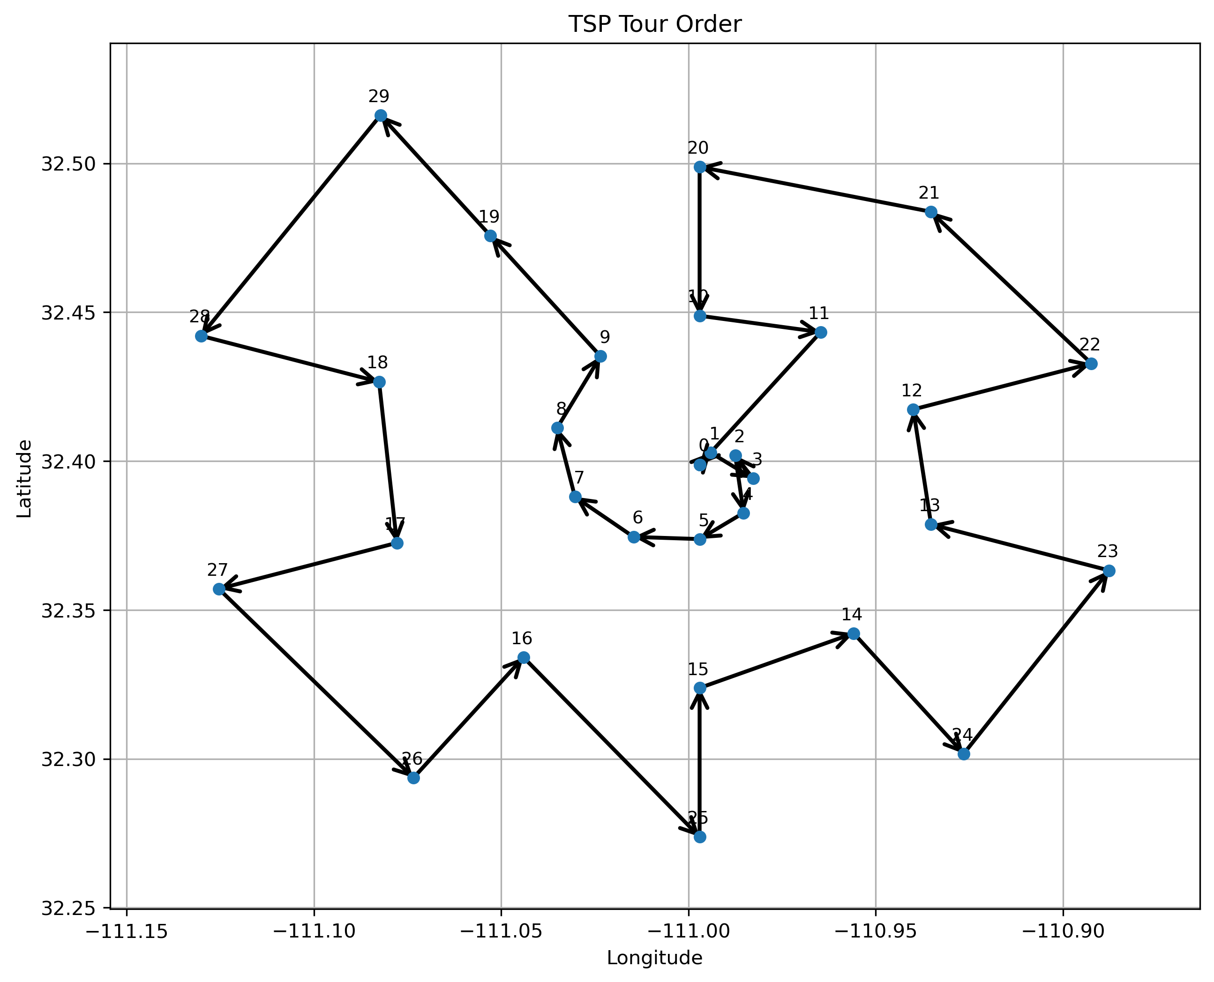
Test Report: 30_spiral.csv (0.072919 s)

Slide 53
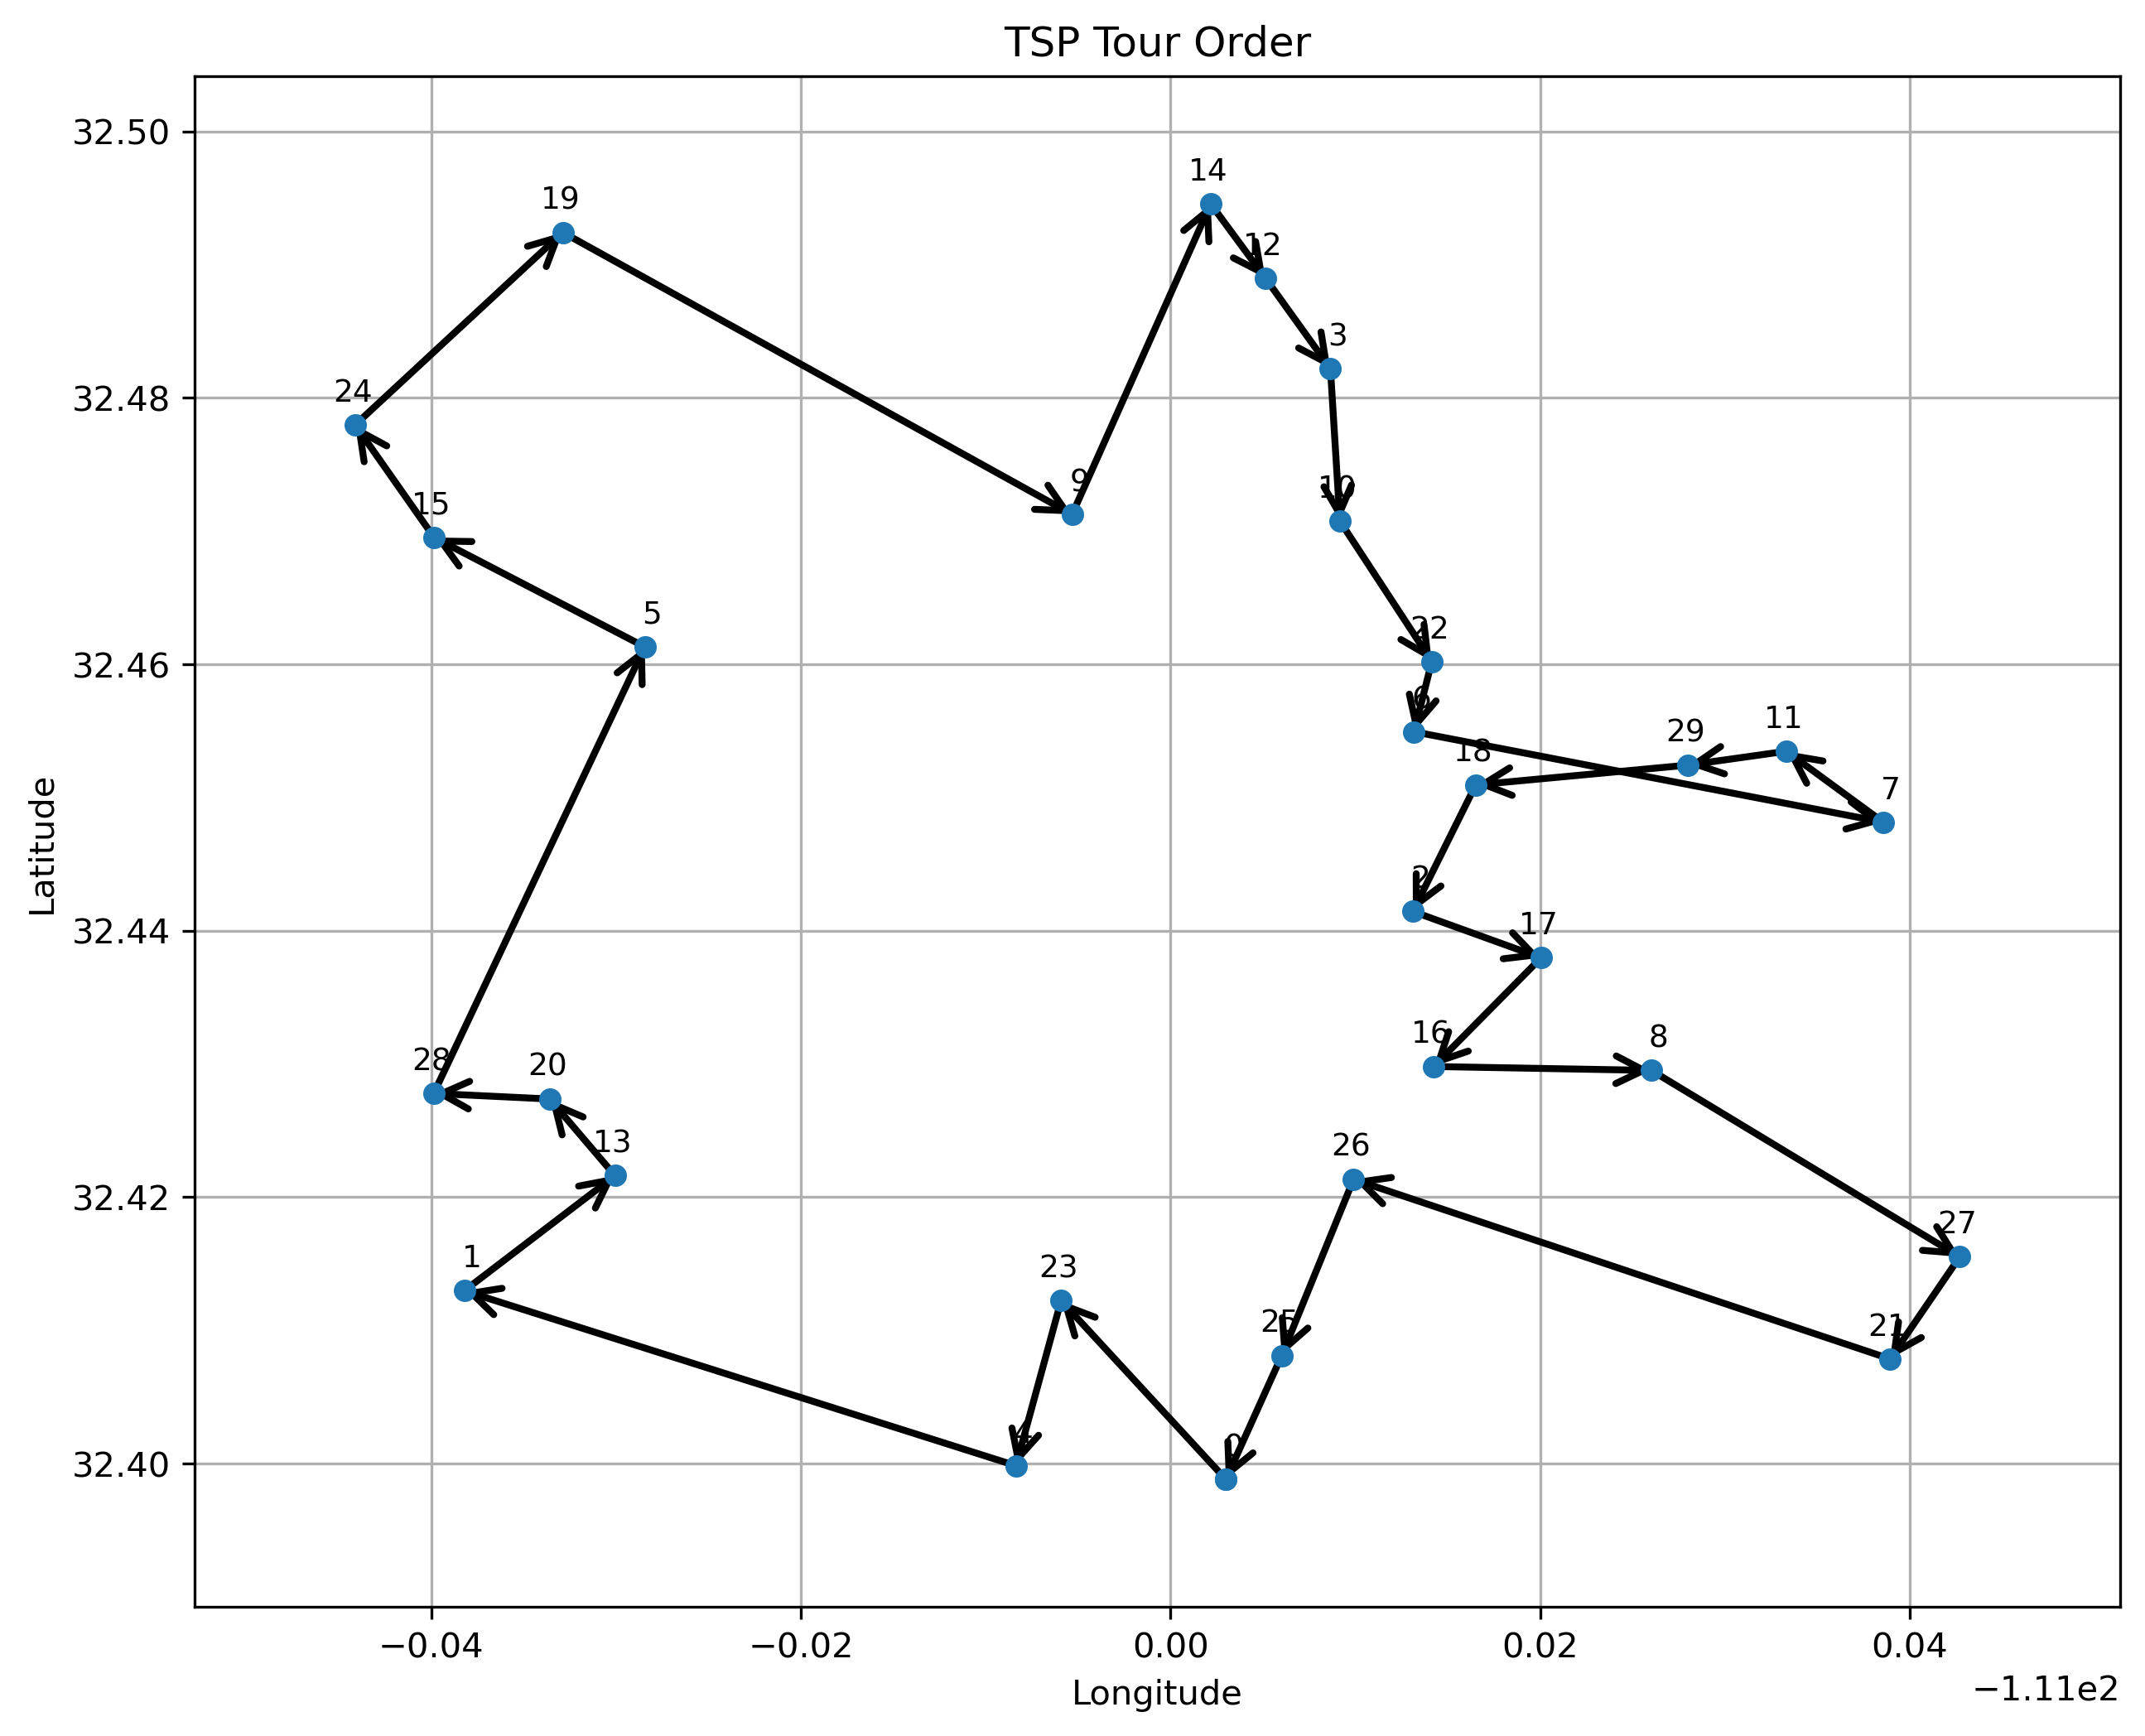
Test Report: 30_oneside.csv (0.042657 s)

Slide 54
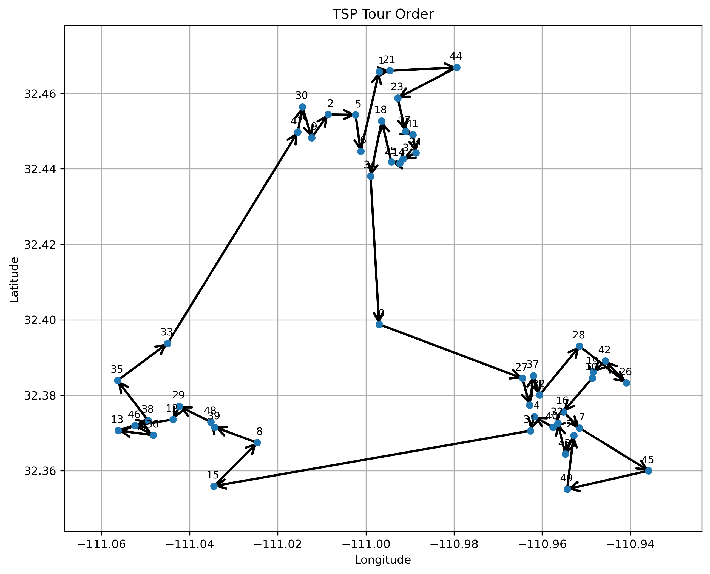
Test Report: 50_clusters.csv (0.123383 s)

Slide 55
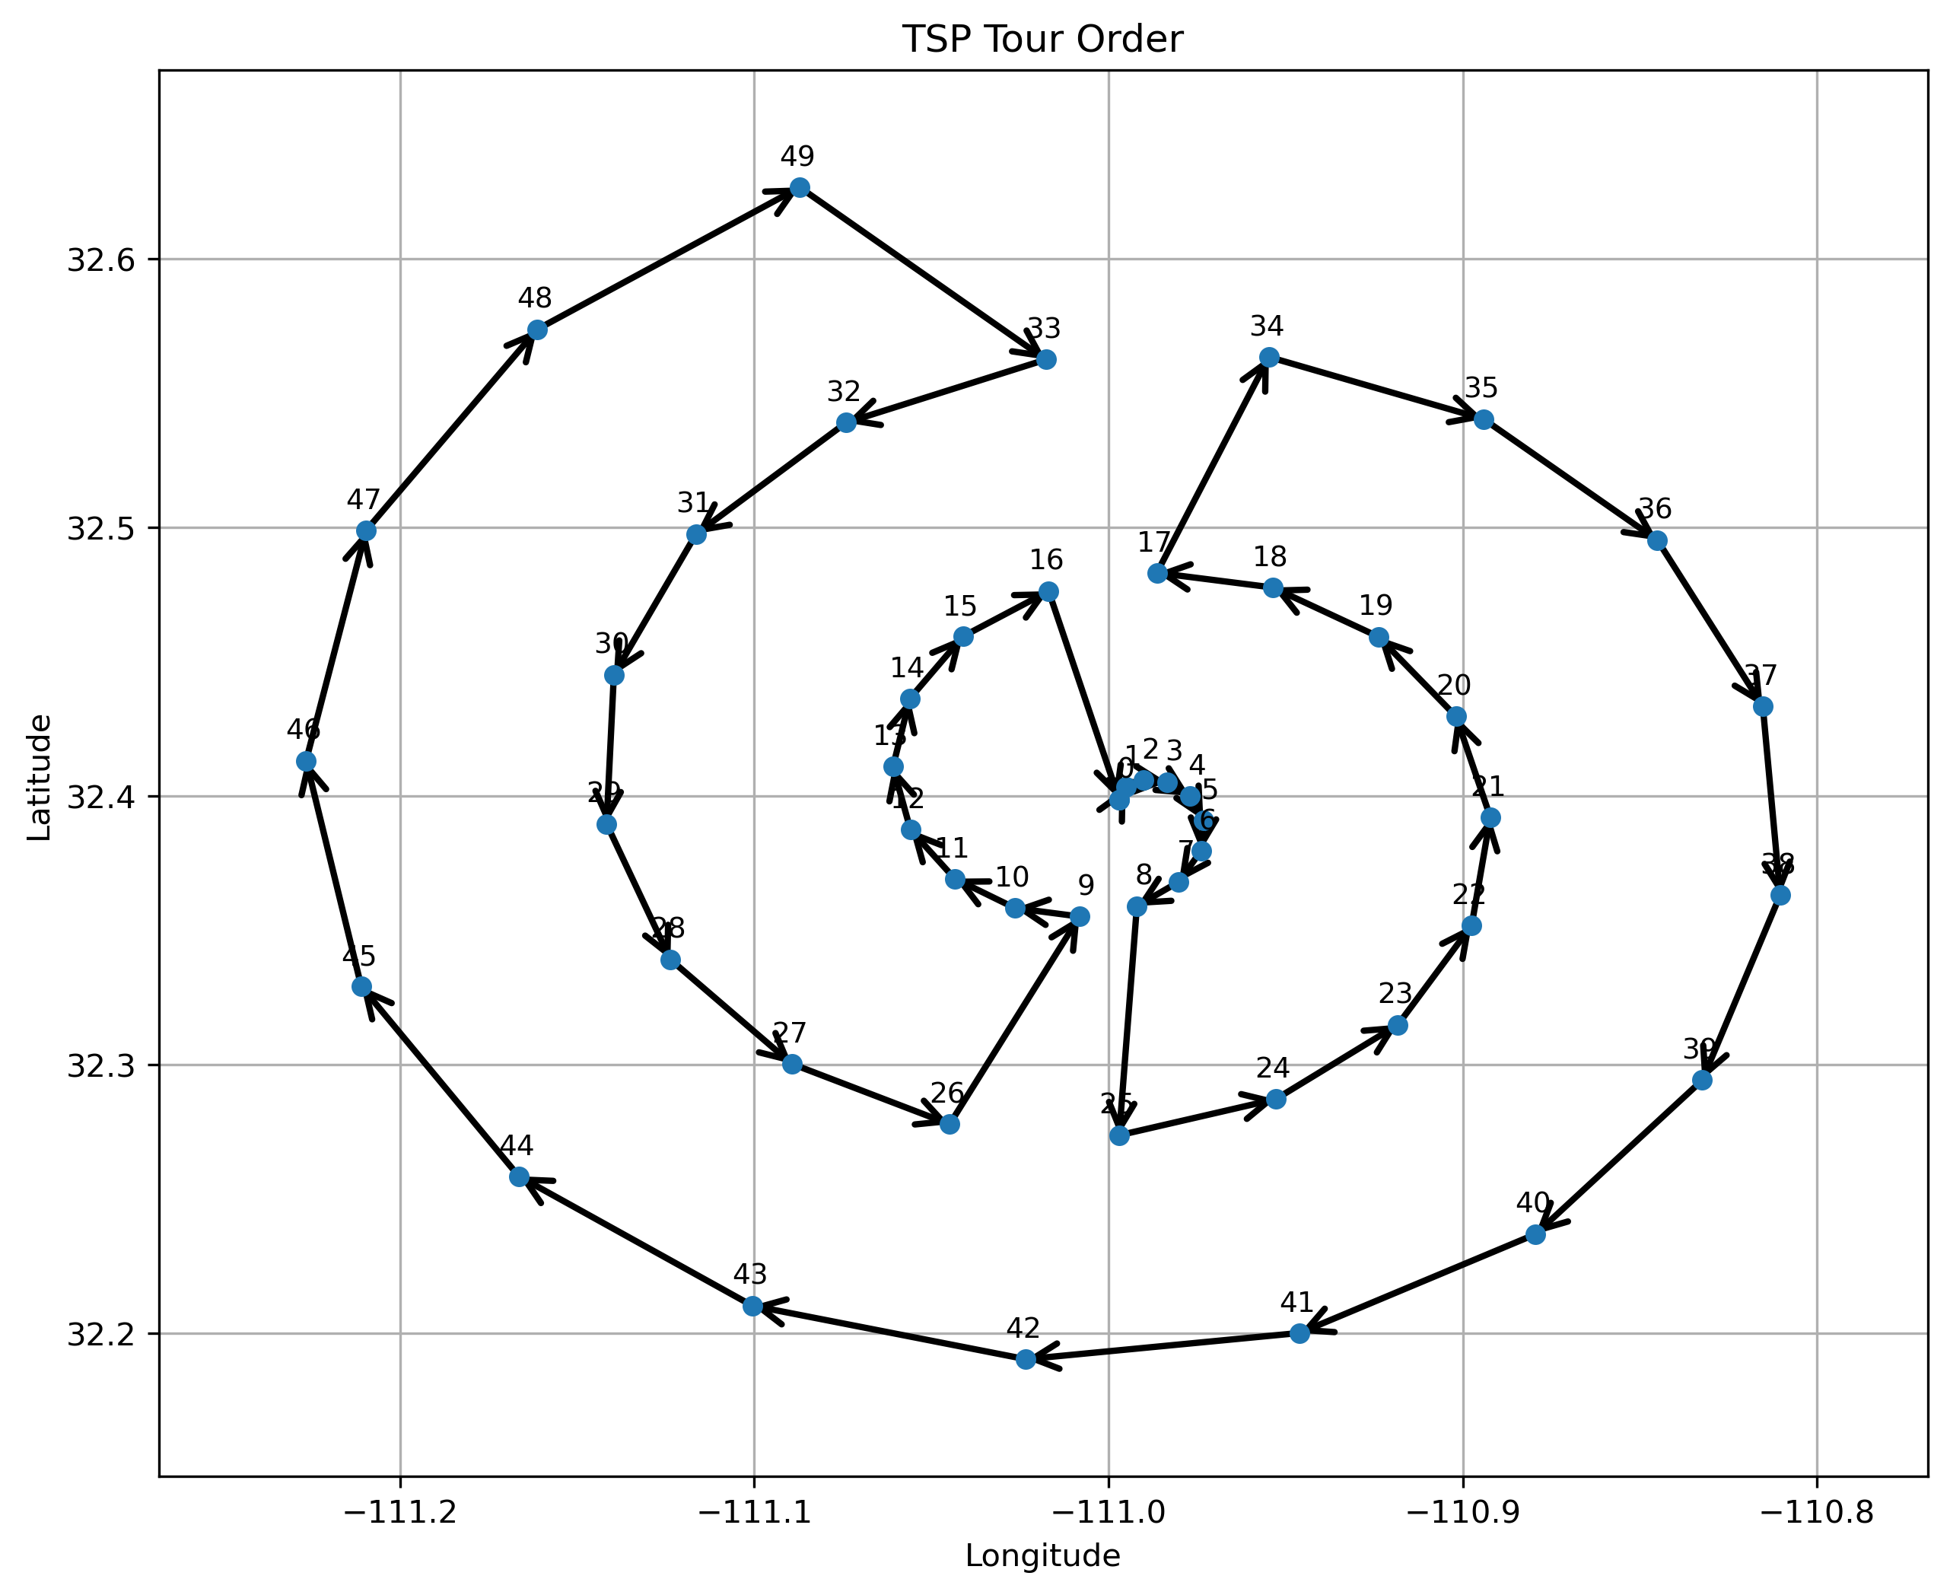
Test Report: 50_spiral.csv (0.083751 s)

Slide 56
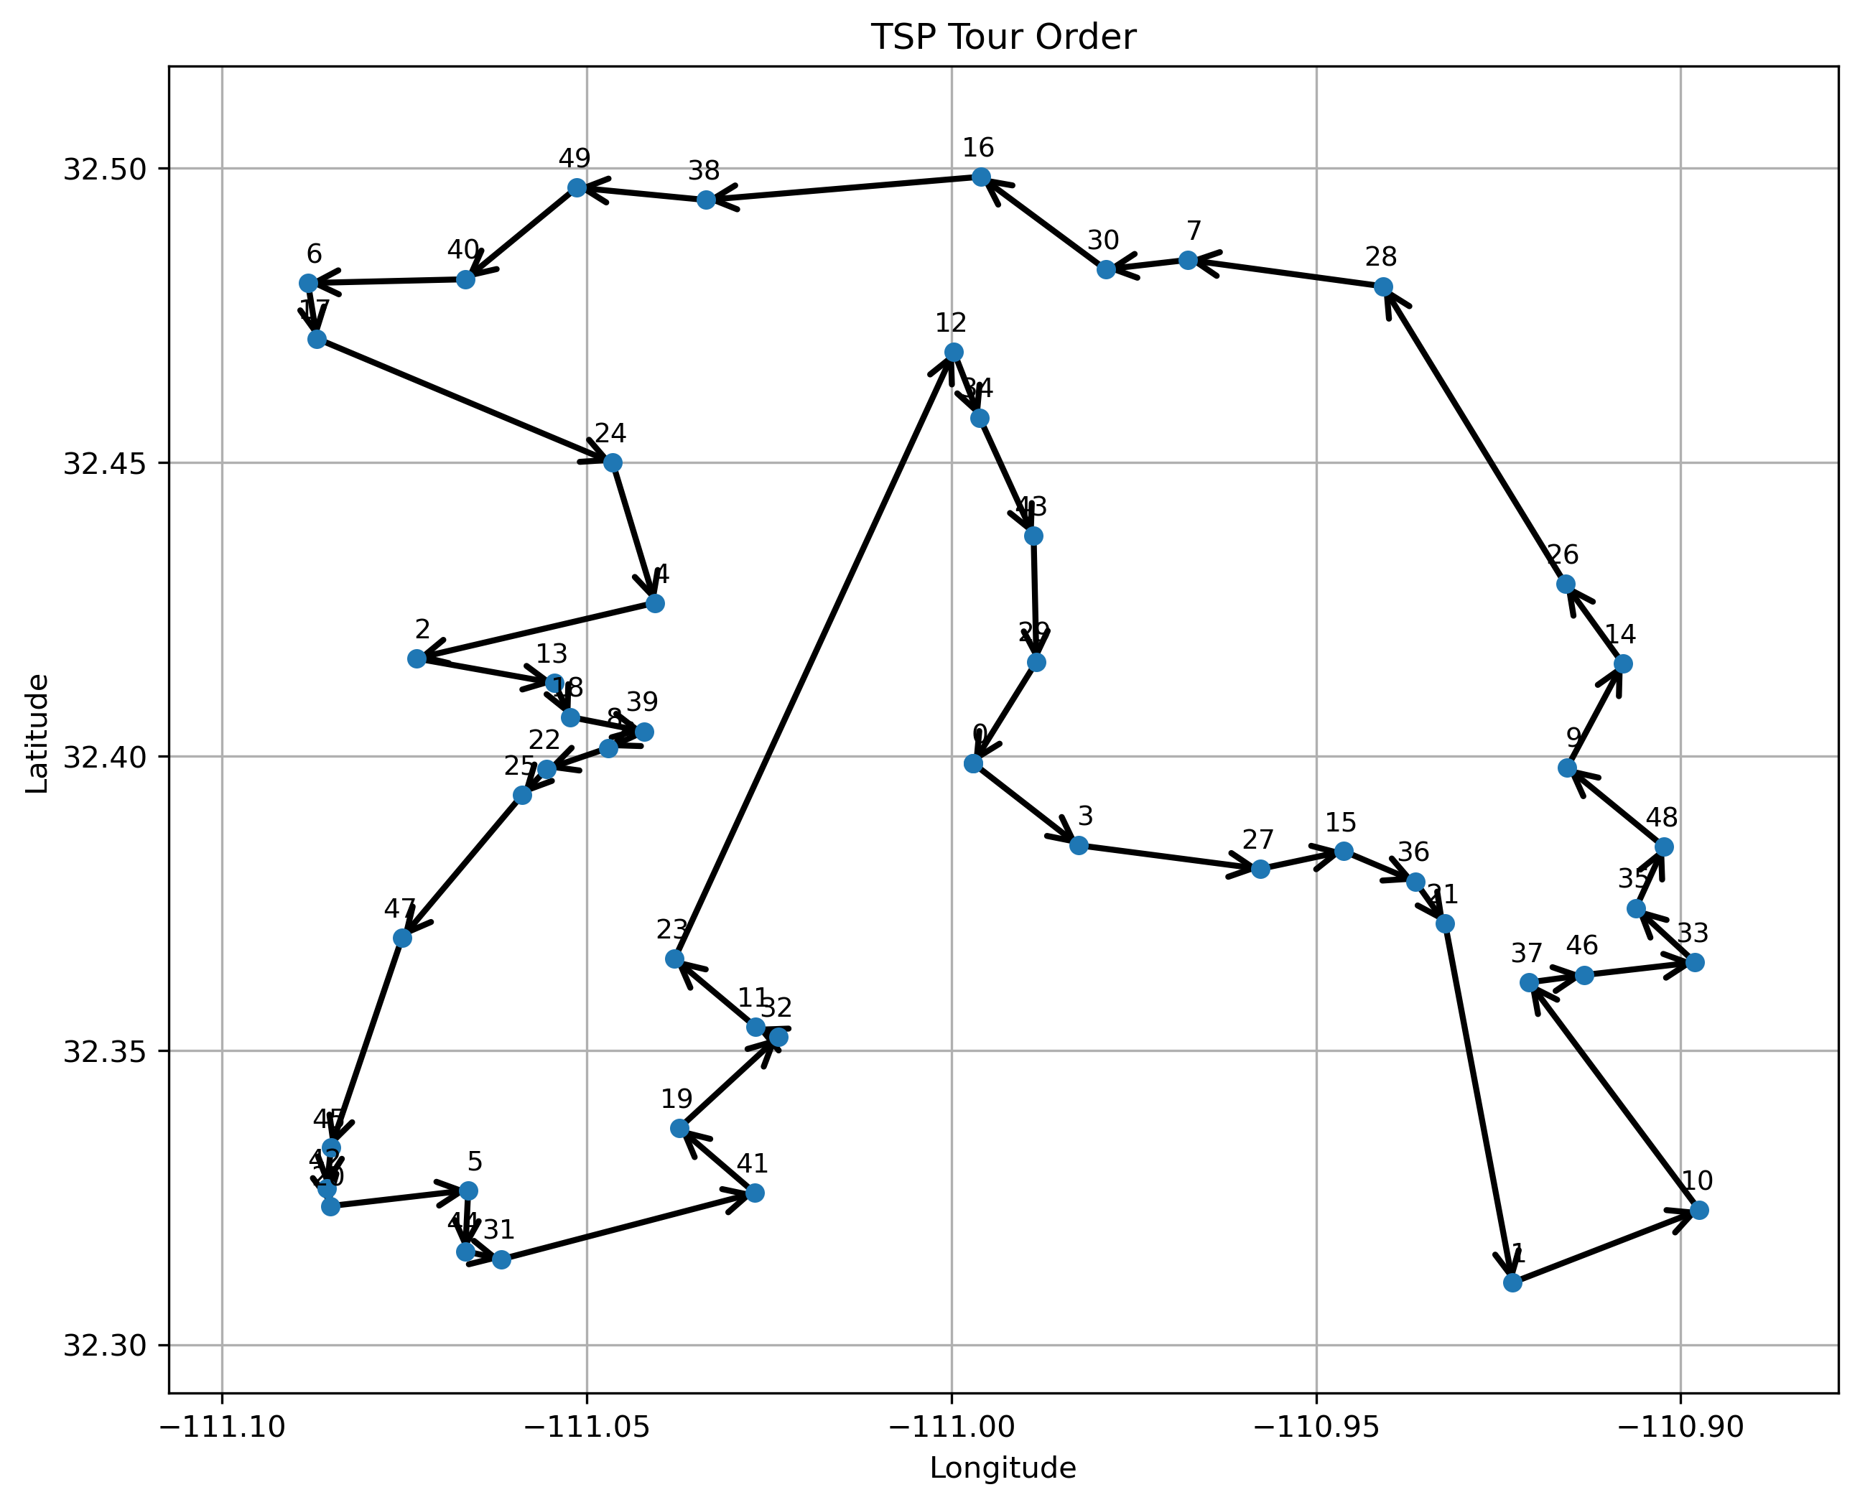
Test Report: 50_allaround.csv (0.141592 s)

Slide 57

Test Report: Software Assurance

Slide 58

Test Report: Software Assurance
Navigation system does not have any memory leaks.
Clang/GCC (compiler) address sanitizer was used to profile the code at compile-time and run-time.

Slide 59
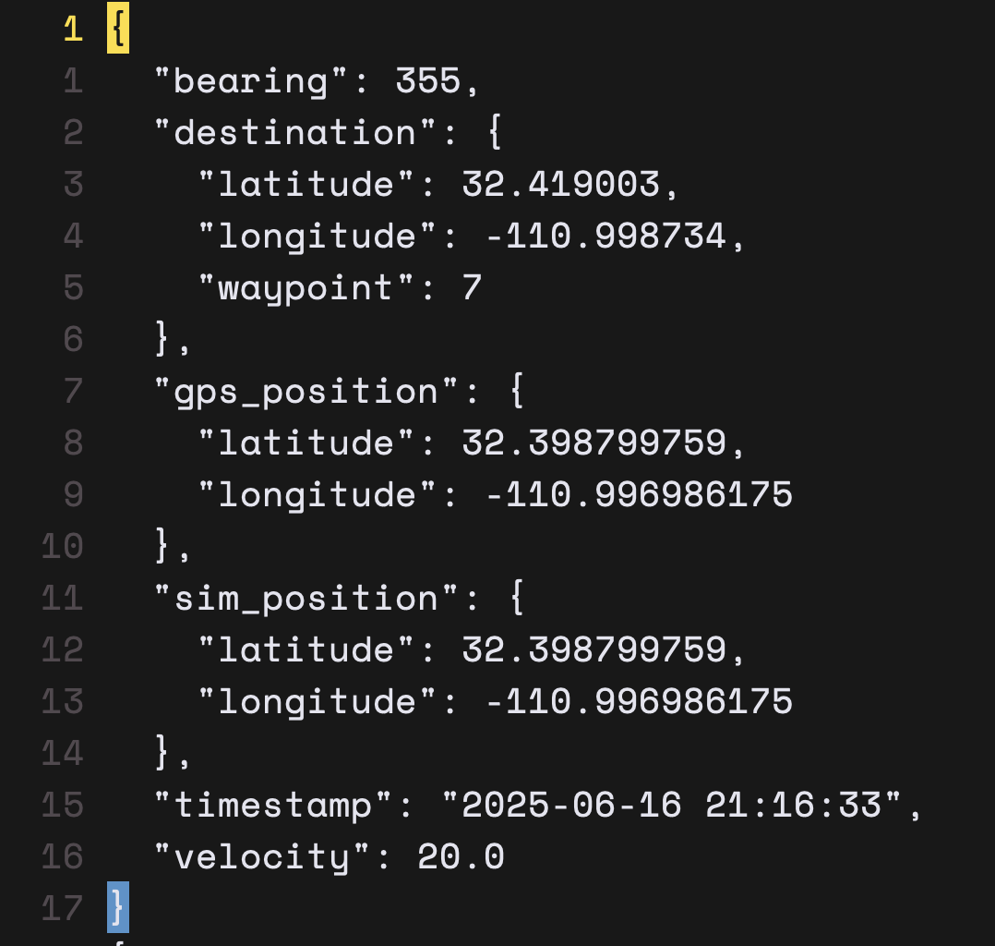
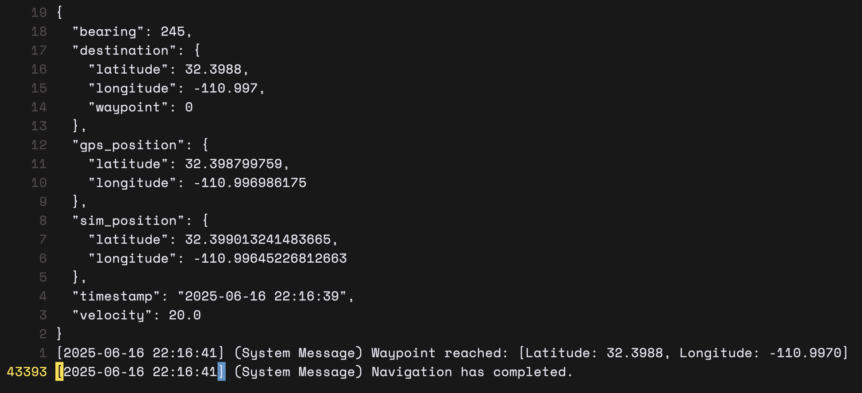
Test Report: Software Assurance (cont’d)
Navigation system logging was tested on a planned tour for 30_lines.csv with proximity radius set to 20 meters and simulation velocity set to 20 meters per second.
Simulation lasted for ~1 hour, and navigation output was generated to completion without crashing.

Slide 60
Test Report: Software Assurance (cont’d)
Officially, the navigation system can run up to 1 hour in providing output.
In theory, the navigation system runs indefinitely if the GPS stream provides data.
The navigation system has not been observed to crash during the various stages of testing and is not designed to crash but rather catch and exit on all errors gracefully.
A ‘crash’ could be defined as an instance where the system gracefully logged and exited on a GPS read error during navigation output which has been observed and is expected and good behavior.

Slide 61
Known Anomalies

Slide 62
Known Anomalies: Risk Assessment
ID | Anomaly Description | Observed Conditions | Frequency | Impact Assessment | Risk Level | Mitigation Strategy
1 | GPS Signal Jitters | Brief drops in GPS connection or intermittent data reception. | Rare | Minor disruptions in real-time navigation accuracy. Temporary reduced reliability of navigation instructions. | Low | Implemented lenient GPS polling logic; gracefully logs errors and resumes normal operations automatically.
2 | Dependency on Concorde Binary | Lack of direct API integration; external Concorde solver binary dependency. | Always | Limits system flexibility; potential performance impacts due to external process invocation overhead. | Medium | Clearly documented usage; potential future refactoring to integrate a dedicated, native TSP solver.
3 | Waypoint File Formatting | CSV input strictly requires latitude and longitude columns in exact order and format. | Always | Risk of user input error leading to incorrect waypoint parsing or runtime failures. | Medium | Comprehensive documentation provided; rigorous CSV format validation implemented.
4 | No GUI Interface Implemented | CLI-based usage with no graphical user interface. | Always | Reduced ease-of-use, particularly for less technical users; may impact broader user adoption. | Low | Planned future GUI implementation; current CLI includes thorough documentation.

Slide 63
Known Anomalies: Overall Risk Assessment
The software is stable and reliable, with no anomalies posing critical or high risk.
Identified anomalies have documented mitigations and clear guidance provided in the user documentation.
The product can be safely released with current anomalies, given the existing mitigation strategies.

Slide 64
Technical Debt

Slide 65
Technical Debt: Summary
ID | Technical Debt Description | Reason for Deferral | Impact if Unaddressed | Recommended Future Action
1 | No GUI Interface Implementation | Prioritization of core navigation logic and reliability. | Reduced user-friendliness; higher learning curve. | Plan incremental development of a lightweight GUI for future releases.
2 | Dependency on External Concorde TSP Binary | Project timeline constraints; complexity of native solver integration. | Limits scalability, adds process overhead, reduces flexibility. | Evaluate and integrate a native or API-based TSP solver.
3 | Strict CSV Waypoint Format Requirement | Initial requirement prioritization and time constraints. | User errors and potential runtime failures if CSV format deviates. | Add enhanced CSV input validation and error handling.

Slide 66
Lessons Learned

Slide 67
Lessons Learned
Shift-Left Security Integration
I should have integrated static application security testing (SAST) tools (e.g., clang-tidy, Bandit) into our CI pipeline from day one to catch vulnerabilities early.
Automated Dependency Scanning
Incorporating an automated vulnerability scanner (e.g., Trivy or OWASP Dependency-Check) alongside our SBOM would have ensured we tracked and addressed third-party risks continuously.
Container Hardening Best Practices
Building minimal, non-root Docker images and running container-scanning checks as part of CI would have reduced our attack surface before deployment.
Expanded Test Automation Coverage
Although I automated 50% of tests, shifting to a test-driven development (TDD) approach would have increased coverage, caught logic flaws earlier, and reduced late-stage debugging.

Slide 68

Success Criteria

Slide 69
Success Criteria: Checklist
System reliably reads GPS data on Raspberry Pi 5 ✅ (slide 22)
Waypoint algorithm guides system from point to point ✅ (slide 30)
Navigation decisions are logged and reproducible ✅ (slide 16)
Software runs continuously without crashing for ≥30 minutes ✅ (slide 43)
Clear, well-documented code and setup instructions ✅ (https://github.com/kimsh02/awns-rpi5)

Slide 70
Thank You

